Slide 1
PRIDA Track 1 (T1)
Online training, 27 April 2020
SMS4DC
Overview

Slide 2
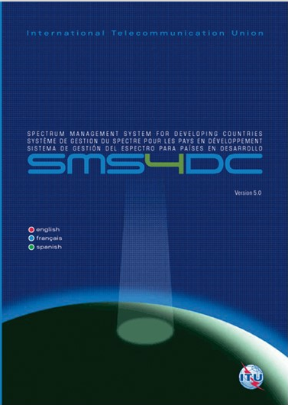
ITU Spectrum Management System for Developing Countries (SMS4DC)
SMS4DC is software designed by ITU based on ITU recommendations
Developed to assist the administrations of developing countries to undertake their spectrum management responsibilities more effectively;
SMS4DC covers terrestrial fixed, mobile, sound and television broadcasting services in the bands above 30 MHz, including GE-06 as well as frequency coordination of Earth stations

Slide 3
Computer aided spectrum management
The use of computers in the spectrum management process has become crucial for most administrations that are faced with the ever-increasing use of the radio frequencies.
Several aspects of this process, such as frequency coordination, administrative procedures (registration and issuing of licenses) and notifications of assignments to the ITU according to the Radio Regulations, are crucial in the establishment of a computer-automated process.
ITU-R Handbook: Computer-aided Techniques for Spectrum Management (CAT) (2015) http://www.itu.int/pub/R-HDB-01

Slide 4
National Spectrum Management
Spectrum management
Spectrum Monitoring
Rules and Regulations
Enforcement
Spectrum Engineering
Spectrum Planning and Allocations
Licensing and Assignment Administration
Frequency Coordination
Standardization
Spectrum management is a combination of administrative and technical activities for efficient utilization of spectrum by users without causing harmful interference in their service area

Slide 5
System architecture
ITU
Tools and Databases
Network
Monitoring System
Spectrum Management System
Monitoring
Database
Technical modules
Data processing modules
Geographical Information System
Spectrum Management Database
Digital Maps
(e.g. Digital Elevation Model)

Slide 6
SMS4DC Development Cycle
2007: SMS4DC Version 1.0
2008: SMS4DC Version 2.0 (Addition of Digital TV planning tools (GE06))
2009: SMS4DC Version 3.0 (Addition of Google Earth and monitoring interface)
2012: SMS4DC Version 4.0 (link to ESMERALDA monitoring software of Thales and additional enhancements, French language)
2014: SMS4DC Version 4.1 (Update of Article 5 according to WRC12, import from new BRIFIC & interface with appendix 7)
2015: SMS4DC Version 5.0 (Revised propagation models based on the latest version of P.452, P.530 and P. 1812, P.1546, Spanish language).
2017: SMS4DC Version 5.1 (HCM, results of WRC-15: revision of the Radio Regulations Article 5 module, the international frequency allocation).
2020: SMS4DC Version 5.2

Slide 7
Structure of the SMS4DC
BR IFIC
SRS
External Database
Interface to the externaldatabases
MAPS
InternalDatabase
LIBRARIES
SMS4DC software
Technical& Administrative Modules
Interface to the externalresources
External Resources and Applications
Monitoring Systems
IDWM
RR App.7

Slide 8
Functions of SMS4DC
Administrative Functions
Graphical User Interface (GIS) Functions (including Map Displays)
Engineering Analysis Functions

Slide 9
Administrative Functions
Comprehensive database (MS Access) of user/license details, with data fields in accordance with ITU recommendations;
Provides complete process from: frequency application, frequency assignment, licensing, ITU plans and Bilateral frequency coordination procedures;
Imports coordination data from ITU BRIFIC & SRS CD-ROM database;
Producing electronic notices, print license, invoice & spectrum fee
Security features: The designated system administrator can define an individual account for each SMS4DC user up to 6 levels of access to the different processes (e.g. licensing, assignment etc). Each user account is named and password protected.

Slide 10
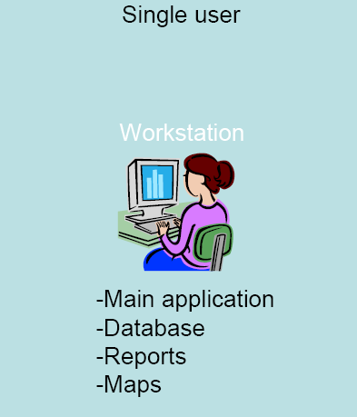
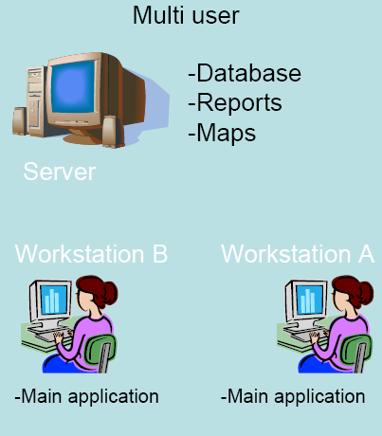
SMS4DC Configuration

Slide 11
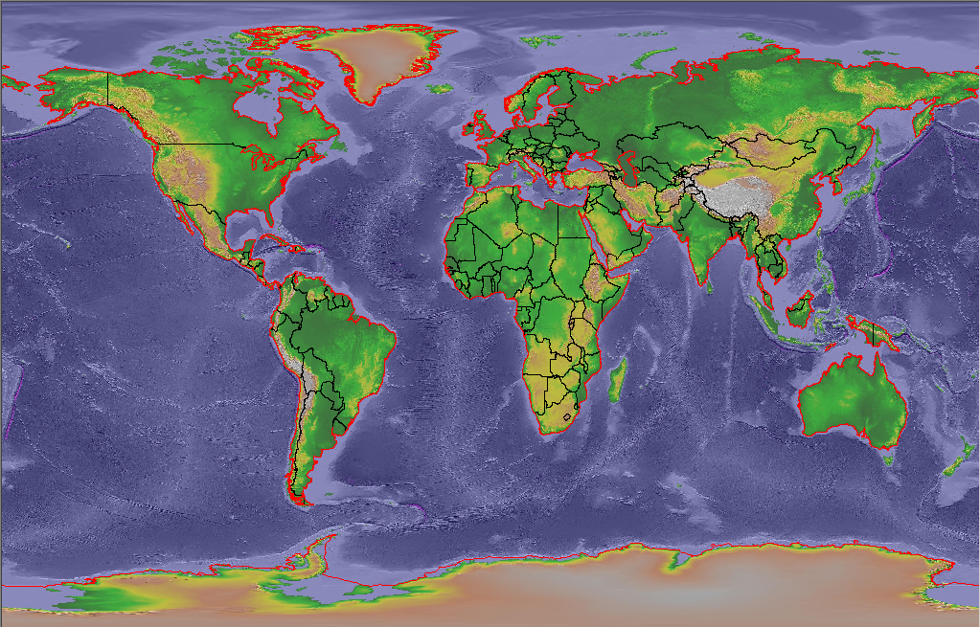
GIS Functions of SMS4DC
User friendly interface with text menus and icon-tool bars;
Display views
International Digital World Map (IDWM)
Digital Elevation Map (DEM) (2-D and 3-D)
Data entry/Assigning of new stations on DEM by mouse point-and-click
Export of maps, overlays and vectors to Google Earth Searching and displaying stations on DEM

Slide 12
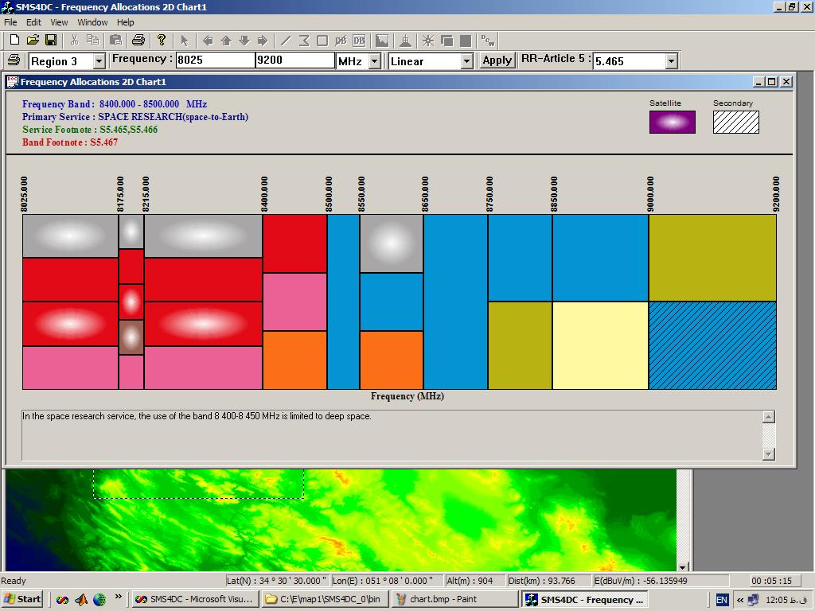
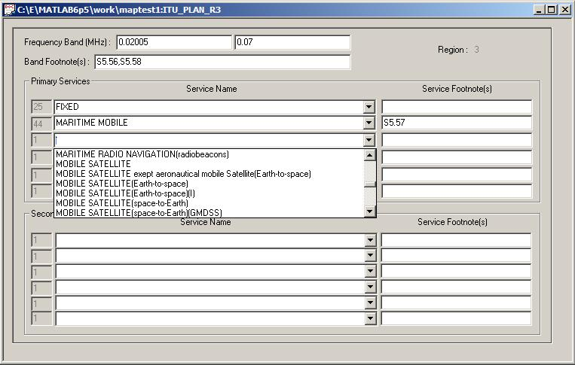
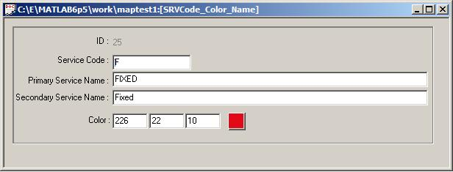
Engineering Functions
International & National frequency allocations table (chart)

Slide 13
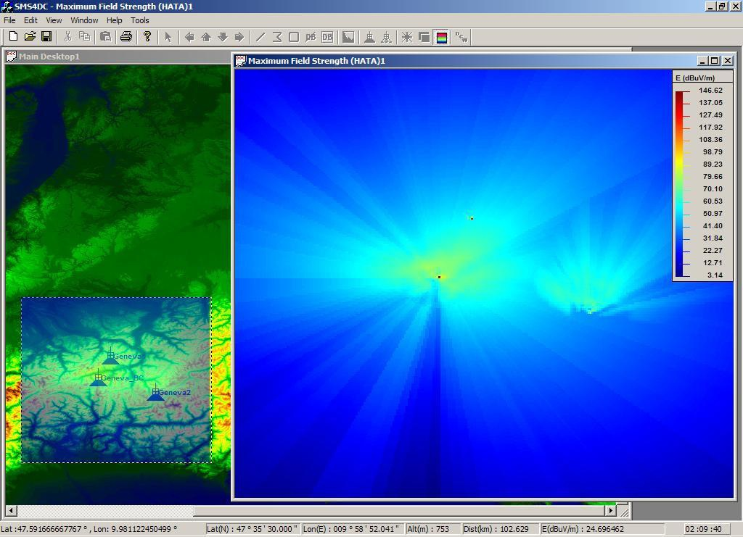
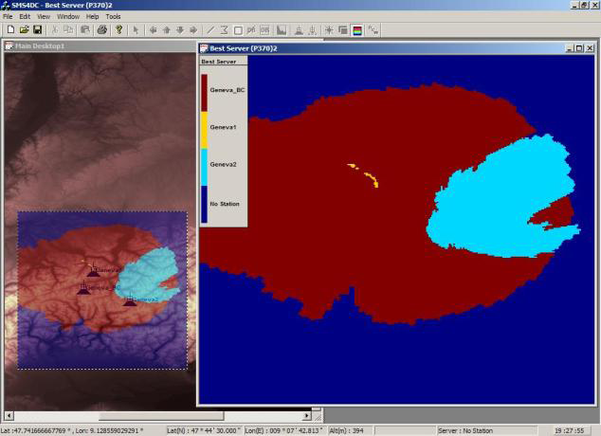
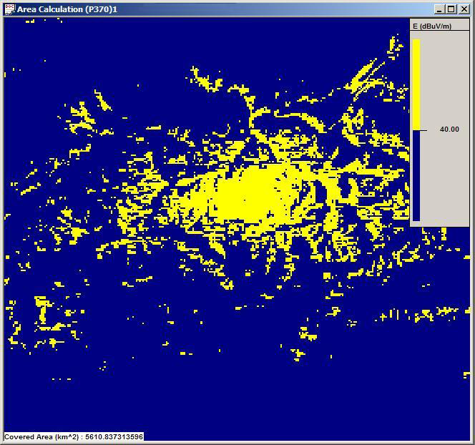
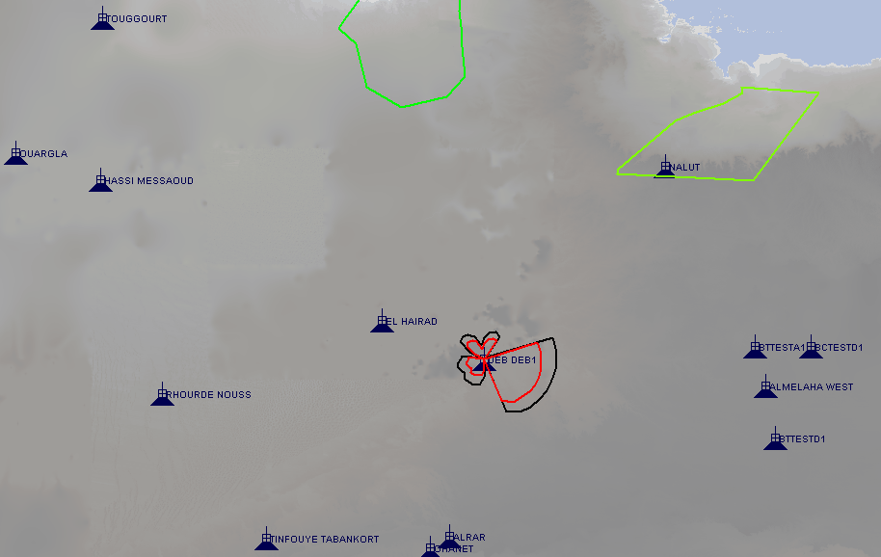
Engineering Analysis Functions
Calculation of coverage area, field strength, field strength contour, network coverage and best server calculations
Maximum Field Strength
Item to calculate and visualize the maximum values produced by more than one transmitting stations at any point inside a predefined rectangular area.
Best Server
Item to calculate and visualize the best serving station at each point among various stations inside a predefined rectangular area.
Coverage area
Item to calculate area in km2 Where inside the area, the field strength value is higher than a threshold value.

Slide 14
Broadcasting services
Co-ordination includes interference analysis and frequency co-ordination tools between Broadcasting Services and between Broadcasting Services and some of the other services (Fixed and Land Mobile only) sharing the frequency bands in the ST61, GE84, GE89, and GE06 Agreements.
Interference analysis methods are in conformity with the relevant requirements of the Agreements

Slide 15
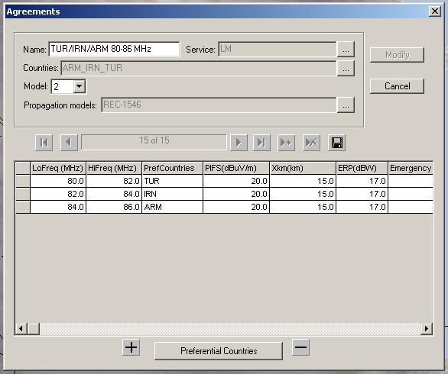
Example for the Land Mobile service – cross border coordination
The example shows a cross border coordination agreement for the band 80-86 MHz among three administrations. Three sub-bands are established, one for each country, giving preferential assignment rights. The limits of the preferential rights are 20 dbuV/m measured at 15 km across the border. For coordination of receivers, a reference transmitter with e.r.p. of 17 dBW is used.

Slide 16
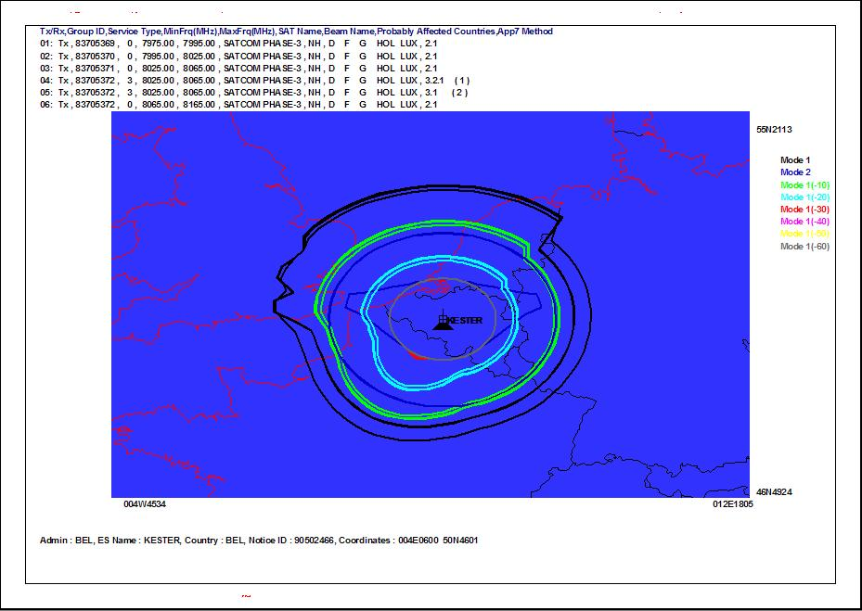
Coordination contours around an Earth station - BR

Slide 17
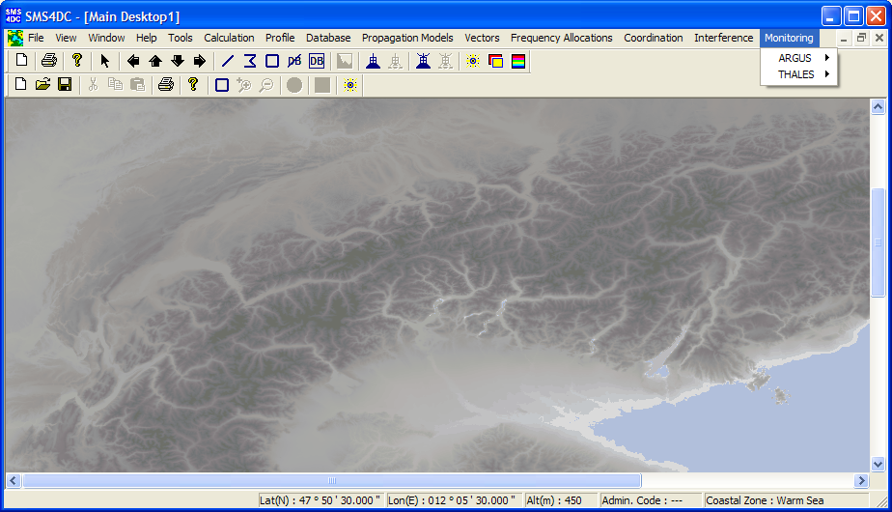
SMS4DC’s Engineering Functions
SMS4DC and monitoring software interface

Slide 18
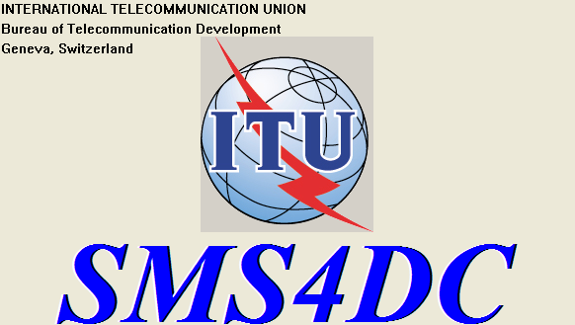
SMS4DC’s Engineering Functions
SMS4DC and monitoring software interface
Monitoring request to SMS4DC
1
Outbox
2
MONITORING
SOFTWARE
Results
4
3
Inbox

Slide 19
MSIP (Republic of Korea) and ITU project
V5 released at the end of 2015
Adding propagation models based on the latest version of
P.452(-16), Prediction procedure for the evaluation of interference between stations on the surface of the Earth at frequencies above about 0.1 GHz
P.530(-16), Propagation data and prediction methods required for the design of terrestrial line-of-sight systems
P.1546 (-5) (Method for point to area prediction for terrestrial services in frequency range 30 MHz to 3000 MHz)
P. 1812 (-4) (A path specific propagation prediction method for point-to-area terrestrial services in VHF and UHF bands);
Intermodulation: calculating interference caused by intermodulation products up to 7th order by using ITU-R SM1134-1 and other resources
General interface between SMS4DC and monitoring software (based on the guidelines prepared for and presented to ITU-R WP1C of the SG1)
Further development of built-in and user specified administrative reports;
Preparation of a general method to import data to SMS4DC
Spanish language added
Preparation of time limited version as a demo tool which can be used for introduction of SMS4DC;
Preparation of the training material for assisting self-learning training of the software.
Train-the-trainer workshop 24 November-2 December 2106, Addis, for around 10 new trainers (English, French and Arabic speaking), in close cooperation with the AFR office

Slide 20
HCM in SMS4DC
V5.1 of SMS4DC released in 2017 (3rd Quarter)
HCM calculations included (EUR)
WRC-15: Article 5 of the RR
HCM4A.dll will be developed by the African experts and when ready, it will be added

Slide 21

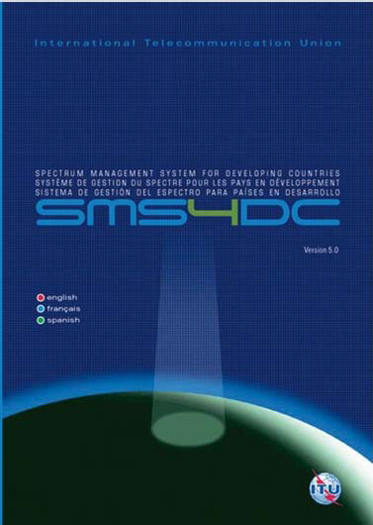
International Meeting of SMS4DC Users
http://www.itu.int/en/ITU-D/Spectrum-Broadcasting/Pages/International-SMS4DC-Users-Meeting_Geneva_December16.aspx

Slide 22
Overview
In order to further develop the tool, it is necessary to collect the opinions and expectations of users and potential users. To this end, a meeting was be organized for the SMS4DC users with the following aims:
summarizing why computerized spectrum management is required;
analysing the main functions of the SMS4DC;
proposing further developments;
understanding the needs, proposals and experiences of targeted users in order to meet their requirements.
The meeting focused on:
highlighting the main functions and structure of spectrum management organization and necessary information for efficient spectrum management;
the role of computer-aided spectrum management;
overview of the SMS4DC, including its structure, main features and different functions;
practical examples;
country presentations from SMS4DC users: how to use the tool and description of their experiences;
requirements, needs, proposals and remarks for further developing the tool.

Slide 23
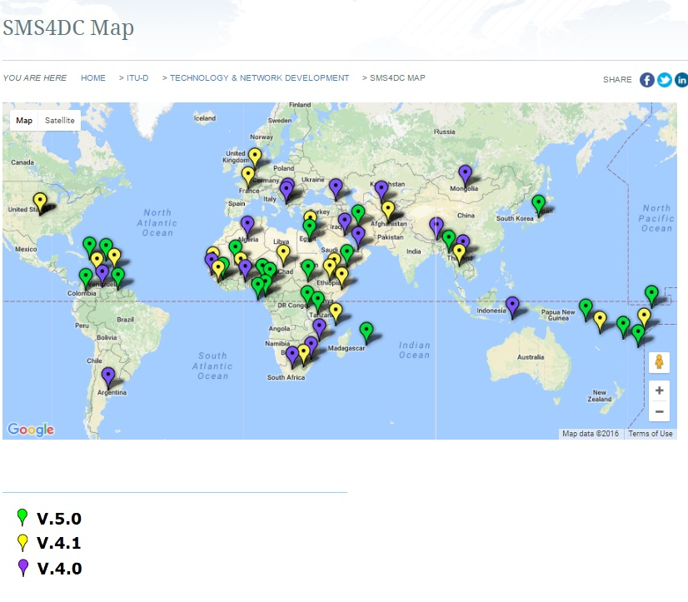
SMS4DC subscriptions before the Workshop

Slide 24
Participants
Around 40 participants (registered 50) from 25 countries.
Presentations: 3 BDT, R&S, ITU Sales, experience of a trainer
Country presentations: Hungary, Switzerland (including HCM), Burundi, Colombia, Myanmar, Sudan
Oral presentations: Timor Leste, Bhutan, Cameroon, PNG, LS
Comments by e-mail: experiences of Pacific Islands

Slide 25
Final conclusions
The participants expressed their view on the usefulness of the software but it can be even better with some improvements. In addition they supported the idea to have this type of meeting once per year and if possible, have also regional meetings of the users.

Slide 26
Proposals for improvements, additions
Administrative functions
Engineering
Graphical
Training
Support
Software
Promotion

Slide 27
Administrative functions
Making easier transfer from Anonymus to licensed station
Improvement of designing license and invoice form
Using copy function in data entry
Export to/from Excel and Word for reporting
Search for stations based on name/ID
Status of license, step-by-step follow up of the licensing process
Export/import between SMS4DC-SMS4DC
Licensing request via web/on-line application form
Upload printed license/invoice (or at least link to them)
Reporting on e.g. number of licenses, stations
Automatic renewal of frequency licenses
Making microwave link entries easier
Supporting management information system

Slide 28
Engineering
Equipment, filter database
Tower database
Higher resolution terrain
Fee calculation

Slide 29
Graphical
Revise the graphical interface
Icons to add/move/remove stations
Frequency allocation chart

Slide 30
Training
Preliminary questionnaire to participants
Preparing more training materials
Background presentations, video on the functions
More spectrum management training is required
Training curriculum
Starting/tutorial/basic information
Training on You Tube
Modular trainings (e.g. engineering/data entry/licensing)
Small demo on the functions for a smaller area

Slide 31
Support
Ticketing for help request
Web/online support
FAQ
Forum for users and forum for developers

Slide 32
Software
Checking other operational system than Windows
Mobile/tablet application
Pre-defined workflow (like e.g. in the Executive overview)
Modular utilization
Checking the possibility of other solution than dongle for authorized utilization

Slide 33
Promotion
Presentations during workshops
Web page
During meetings of Regional Organizations
Flyers, brochures
Packing together with other spectrum management assistance
Distributing information video/tutorial by a BDT Circular
Using BRIFICs for distribution of information about SMS4DC
Regional roadshows (1-2 days, back-to-back with other workshops)
Presentations during WRS and RRS

Slide 34
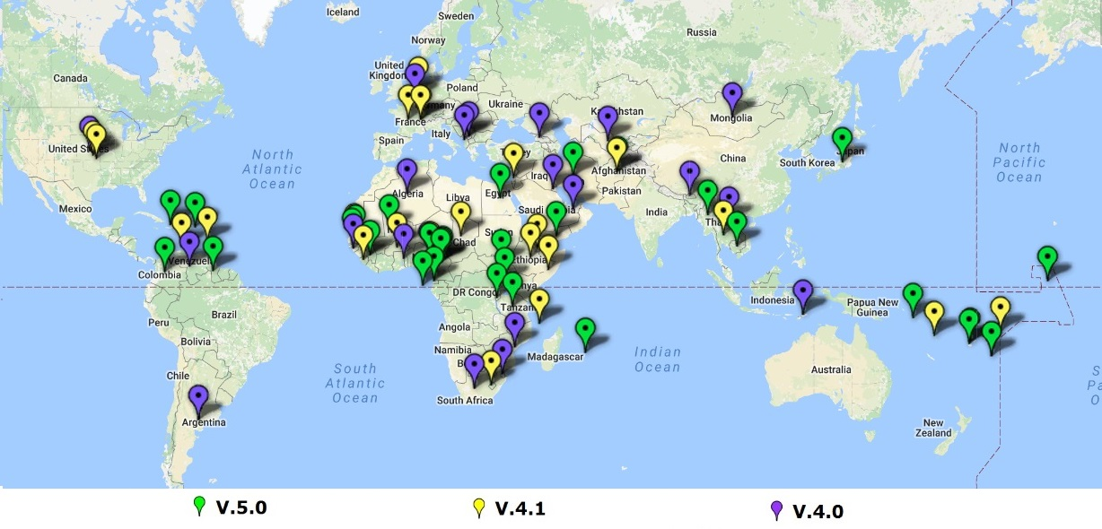
SMS4DC subscriptions after the Workshop

Slide 35
PIRRC project (Pacific Islands)
While most of the smaller islands are considering or have procured the SMS4DC systems only few have implemented it as their spectrum management system.
The problems include the lack of the basic like:
Absence of a national frequency allocation table;
Absence of resources for systematic spectrum management;
Lack of training.
All countries who have responded to the survey indicate that while they will adopt SMS4DC they need additional training and more importantly training material that would allow them to work and learn on the system with limited supervision.
The PIRRC Project will be conducting additional training in the first quarter of 2017 and will include the preparation of training aids for the users.
Direct beneficiaries of PIRRC are FSM; Kiribati; Marshall Islands; PNG; Samoa; Solomon Islands; Tonga; Tuvalu and Vanuatu.
Countries that are not are beneficiaries Cook Islands; Fiji; Nauru; Niue; Tokelau and Palau.
Purchased SMS4DC for 10 users
Provided higher resolution map (in 2018)

Slide 36
Republic of Korea and ITU project
Project activities
To improve administrative function and user interface for spectrum management, functions below listed should be newly made or improved:
Improvement of designing license and invoice of fee form
Adding copy function in data entry to avoid repeating same data
Improvement of data export and import function to Excel, Word and other commercial software
Adding search function for stations based on name or ID
Export and Import data between SMS4DC – SMS4DC
To make on-line license application possible, set up sample license web pages and link applicant’s data to SMS4DC database
Upload of printed license or invoice(pdf or jpg format) to SMS4DC database or provide a link function to the documents saved in separate place
Macro function or simplified process for repeated similar stations’ licensing

Slide 37
Republic of Korea and ITU project - new
For better radio communication engineering and easy work for licensing, functions below listed should be newly made or improved:
Based on the user country’s request, provision of non-commercial higher resolution(around 90 m) map based on freely available data
Adding new database of filter, tower and other available commercial products database of radio communication equipment
To calculate licensing fee, adding formula configuration and calculation function for licensing fee or importing formula function from other program i.e. Excel, based on the country’s law and regulation
Improving graphical user interface, i.e. add icon of linking and removing linked stations etc.
For data protection, adding automatic back up menu to separate storage device

Slide 38
Republic of Korea and ITU project - new
To closely support users and exchange useful information and experiences of users
closed on-line forum should be operated and this forum may include FAQ, bulletin board and other necessary functions for users. To facilitate this forum, the developers and experts of SMS4DC should participate in it and timely provide answers for users’ questions.
Preparation of additional training materials
Making video with e.g. recording of training classes for SMS4DC software and uploading the videos to You Tube and other sharing site for learners
Preparation of the training videos as a multimedia DVD and releasing it for assisting self-learning users
Final approval test of the revised version of SMS4DC software package:
Preparation of a protocol for testing and test the revised version of the SMS4DC software
Execution of the approval test of the SMS4DC software on the basis of such test protocol, with the participation of the SMS4DC developers, experts and trainers, and ITU staff from BR and BDT

Slide 39
Additional experts for development
- New experts can be involved in developing stand-alone modules
These modules will be added to the software by the existing experts
Example: HCM module developed by an expert from Lithuania and inserted to the SW by the present experts.

Slide 40
How to order
ITU Sales
https://www.itu.int/pub/D-STG-SPEC
Publication notice
https://www.itu.int/dms_pub/itu-d/opb/stg/D-PN-395-17-PDF-E.pdf
Reduction for Member States, Sector Members, Associates (15%)
Reduction for LDCs (80%)

Slide 41
For further reading:
ITU Handbook - Computer-Aided Techniques for Spectrum Management (CAT), 2015
ITU Handbook on National Spectrum Management, 2015
SMS4DC 5.0 User Guide
ITU Handbook on Spectrum Monitoring, 2011
Recommendation ITU-R SM.1370-2 (08/2013)
Design guidelines for developing automated spectrum management systems
Recommendation ITU-R SM.1537 (08/2013)
Automation and integration of spectrum monitoring systems with automated spectrum management
Recommendation ITU-R SM.1604 (02/2003)
Guidelines for an upgraded spectrum management system for developing countries

Slide 42

Thank you!

